Slide 1
Just One: SoPra FS2020 Milestone 2
A Presentation from Group 15
Charlotte Eder, Minh Phuong Vu, Kai Mitiyamulle Arachchige, Jordan Cedeño, Raphael Haemmerli

Slide 2
Table of Contents
User Interface Design Mock-ups
Diagrams
User Stories and Sprints
REST Specifications and Test Cases

Slide 3
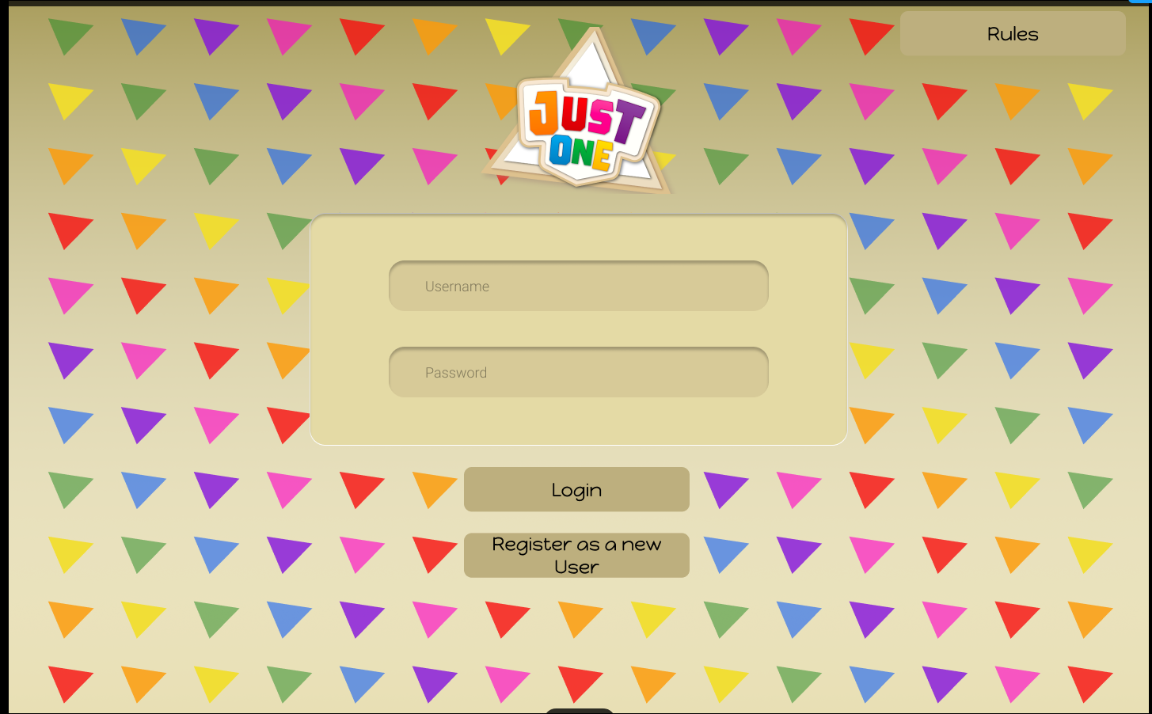
User Interface Design Mock-ups
Login Page

Slide 4
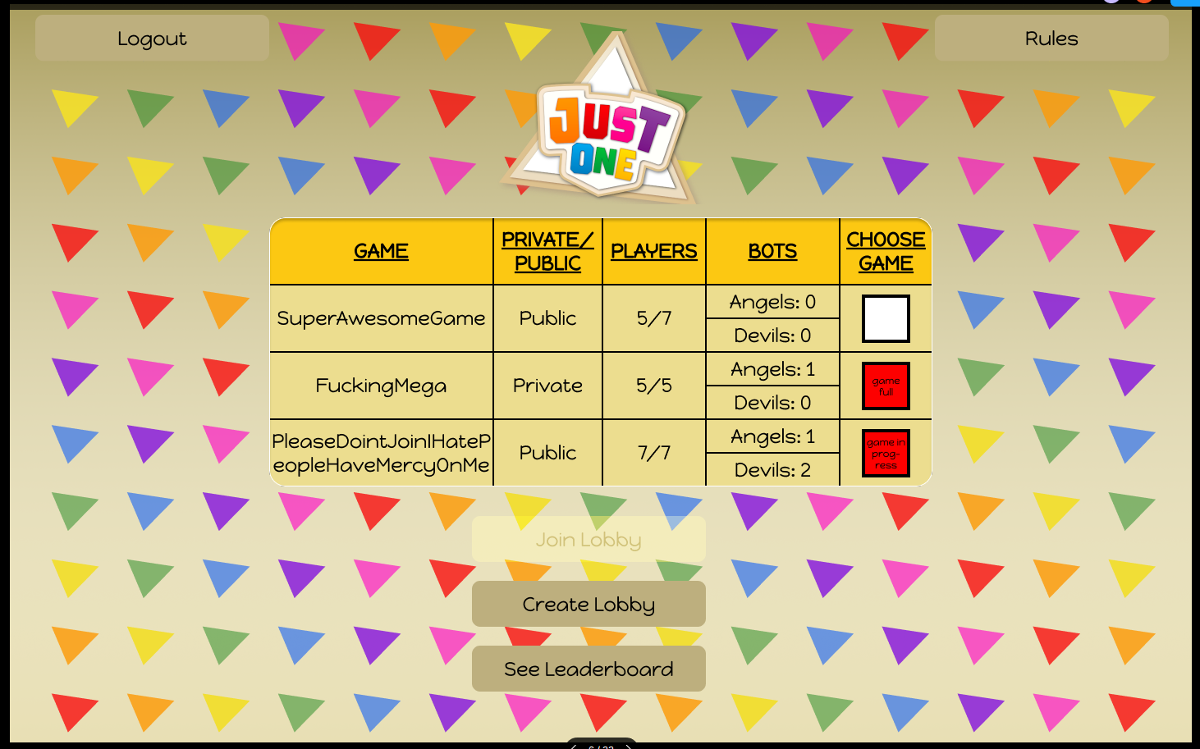
User Interface Design Mock-ups
Lobby Page

Slide 5
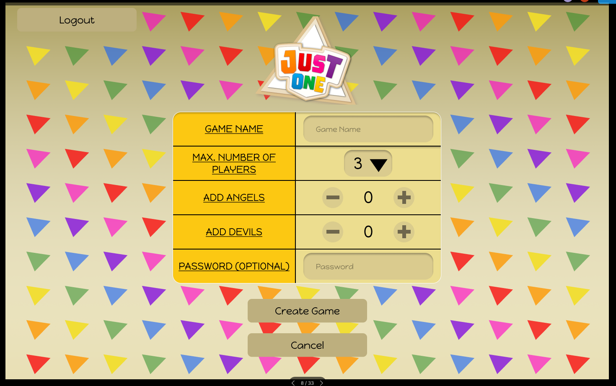
User Interface Design Mock-ups
Game Creation Page

Slide 6
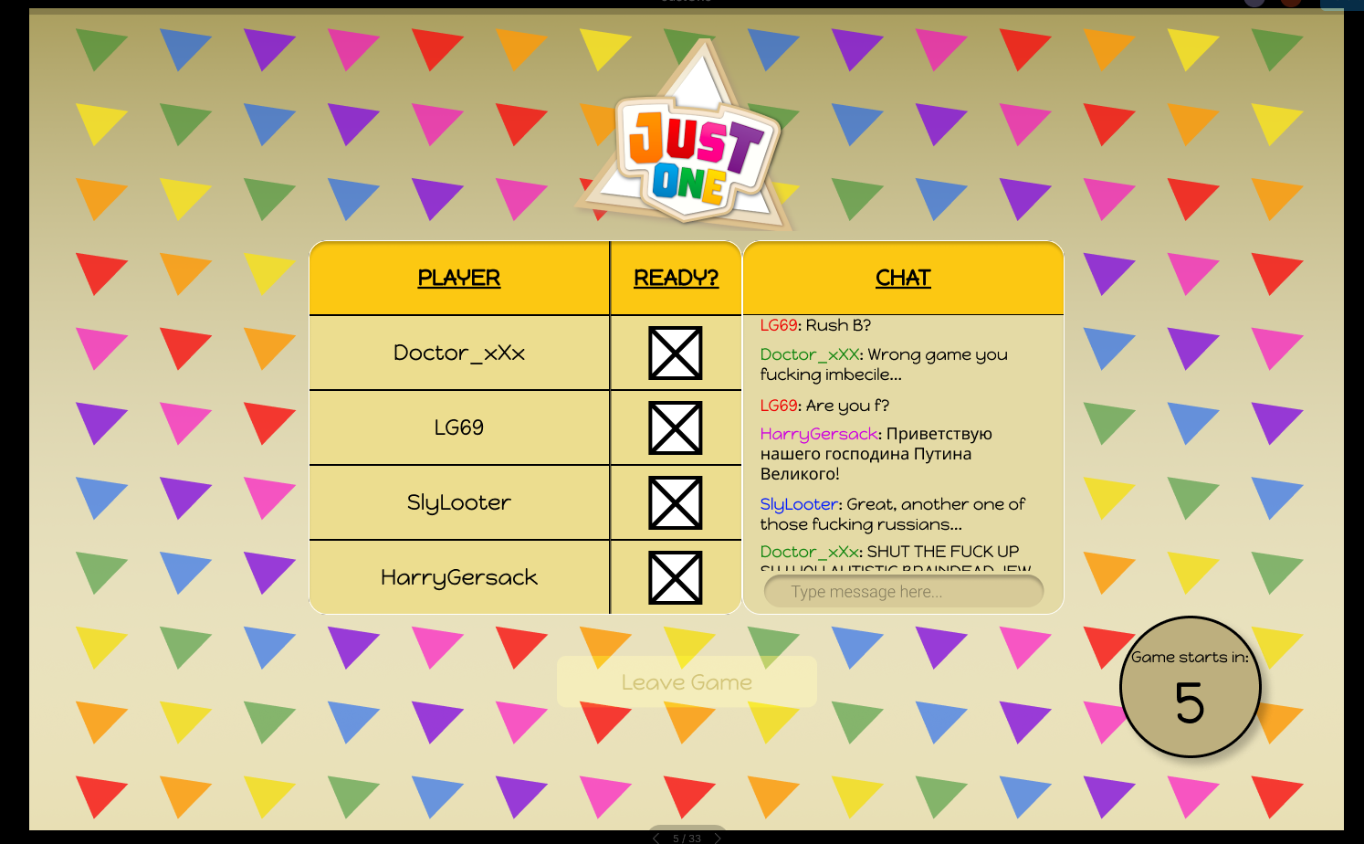
User Interface Design Mock-ups
Game Lobby Page

Slide 7
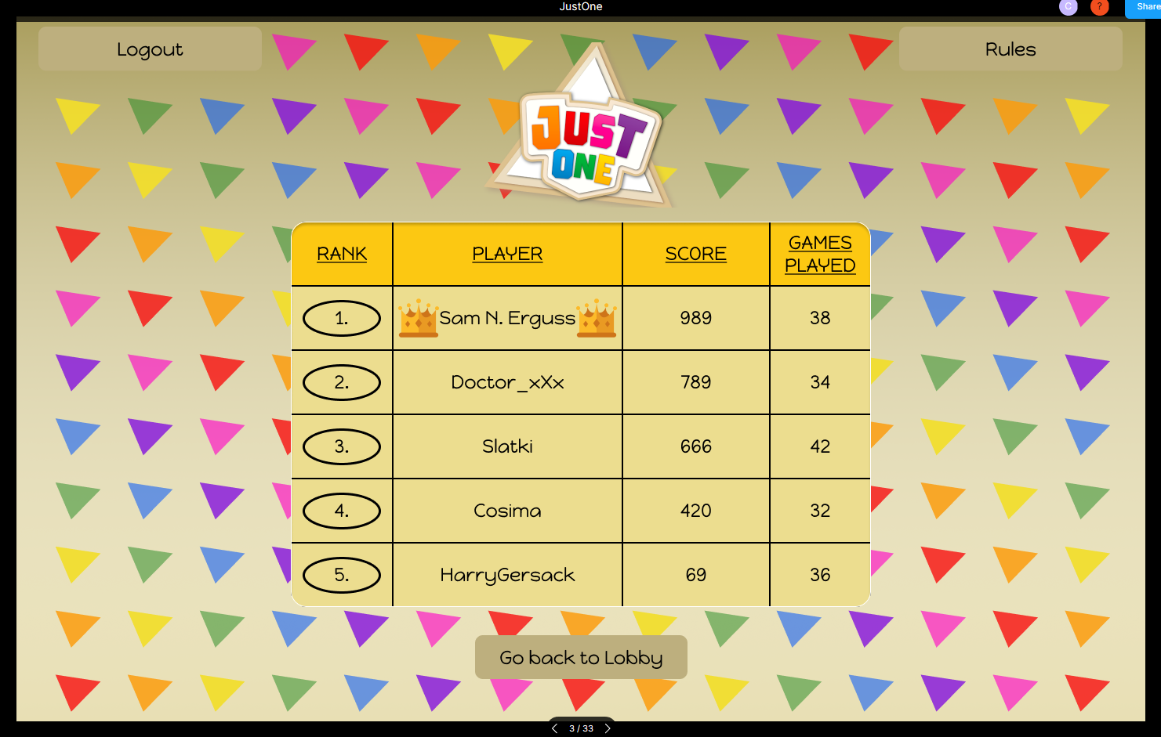
User Interface Design Mock-ups
Leader board Page

Slide 8
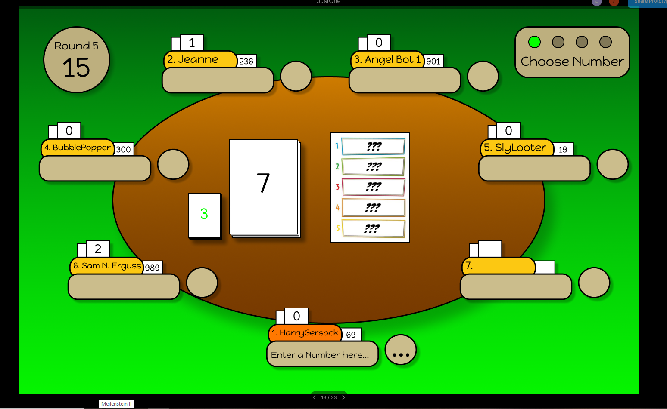
User Interface Design Mock-ups
Game Page: Choose Word

Slide 9
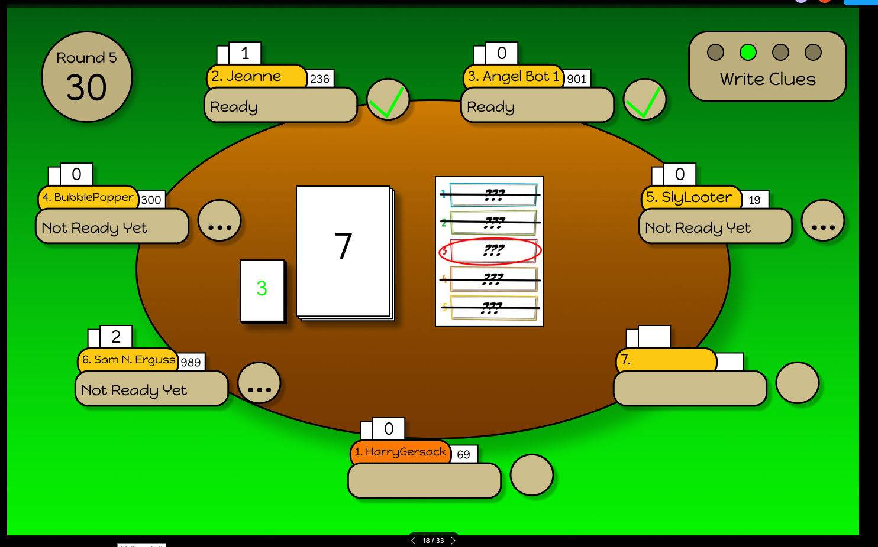
User Interface Design Mock-ups
Game Page: Write Clues (POV of 1)

Slide 10
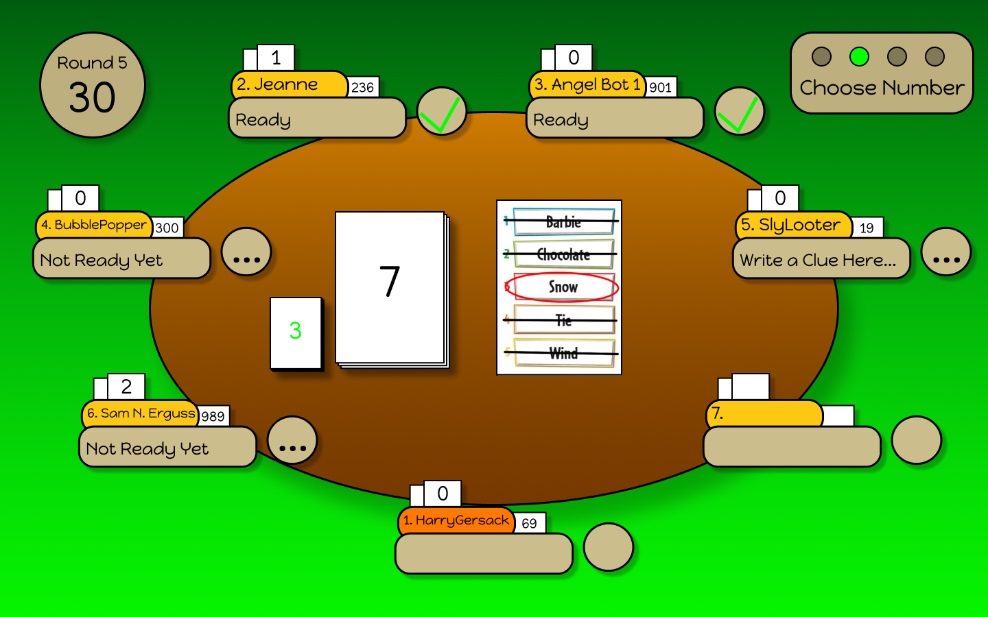
User Interface Design Mock-ups
Game Page: Write Clues (POV of Player 5)

Slide 11
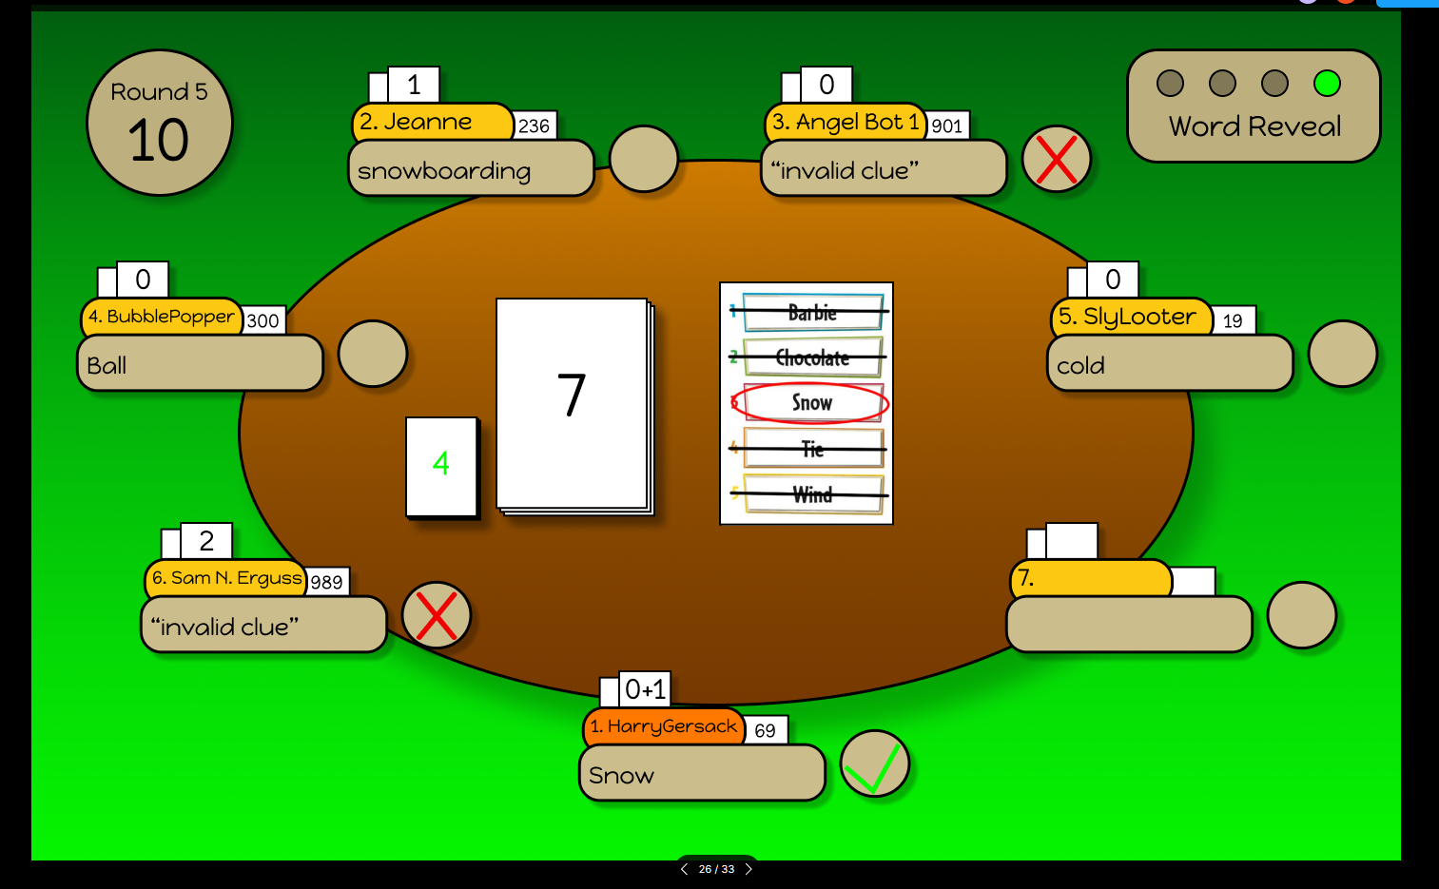
User Interface Design Mock-ups
Game Page: Guess Word

Slide 12
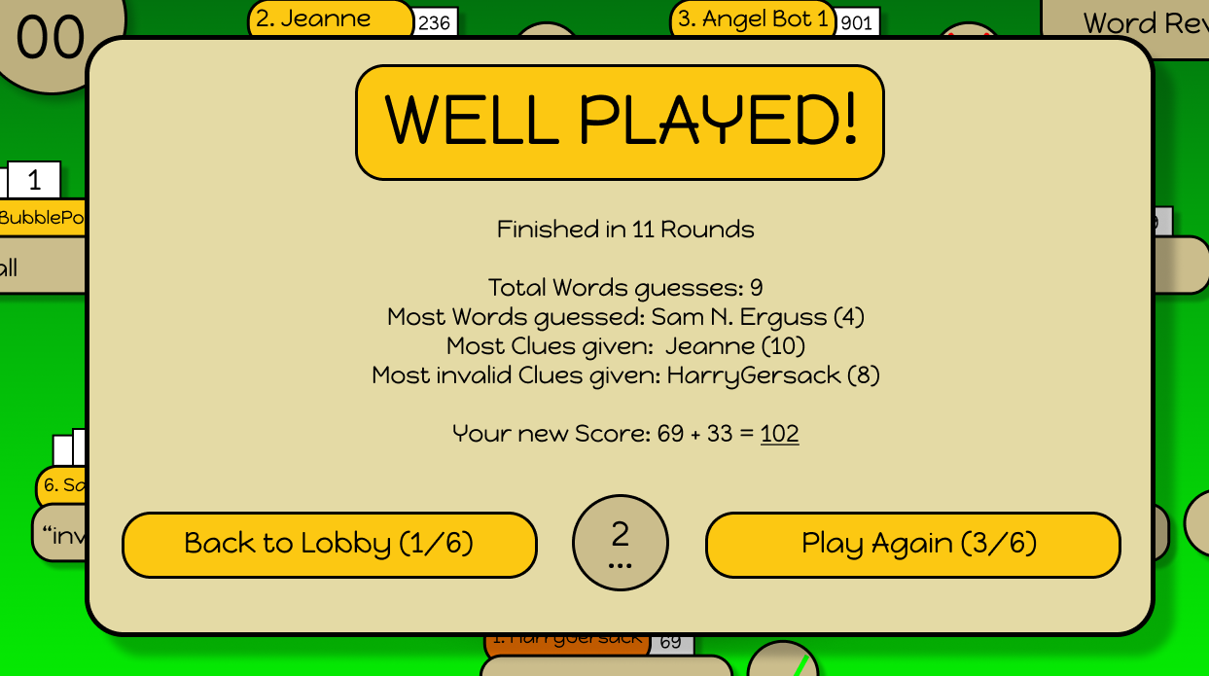
User Interface Design Mock-ups
Game Page: Game End

Slide 13
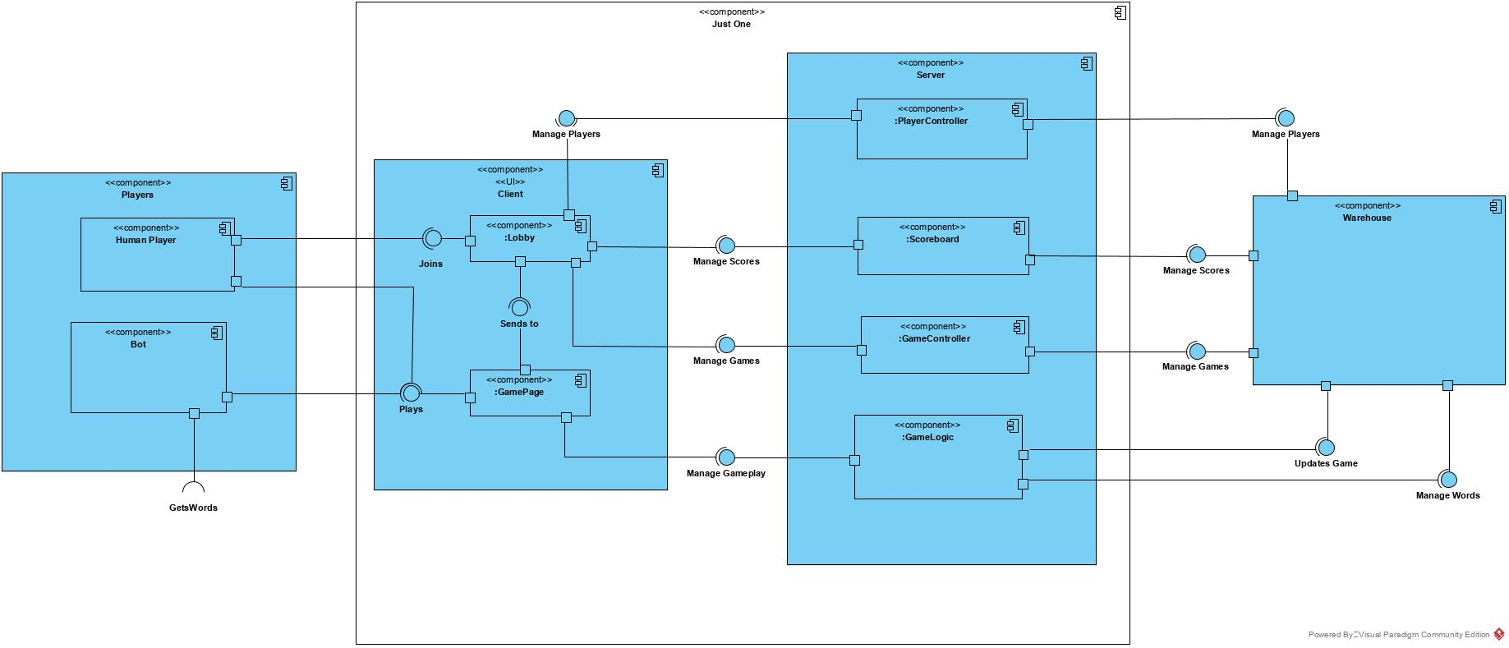
Diagrams
Component Diagram

Slide 14
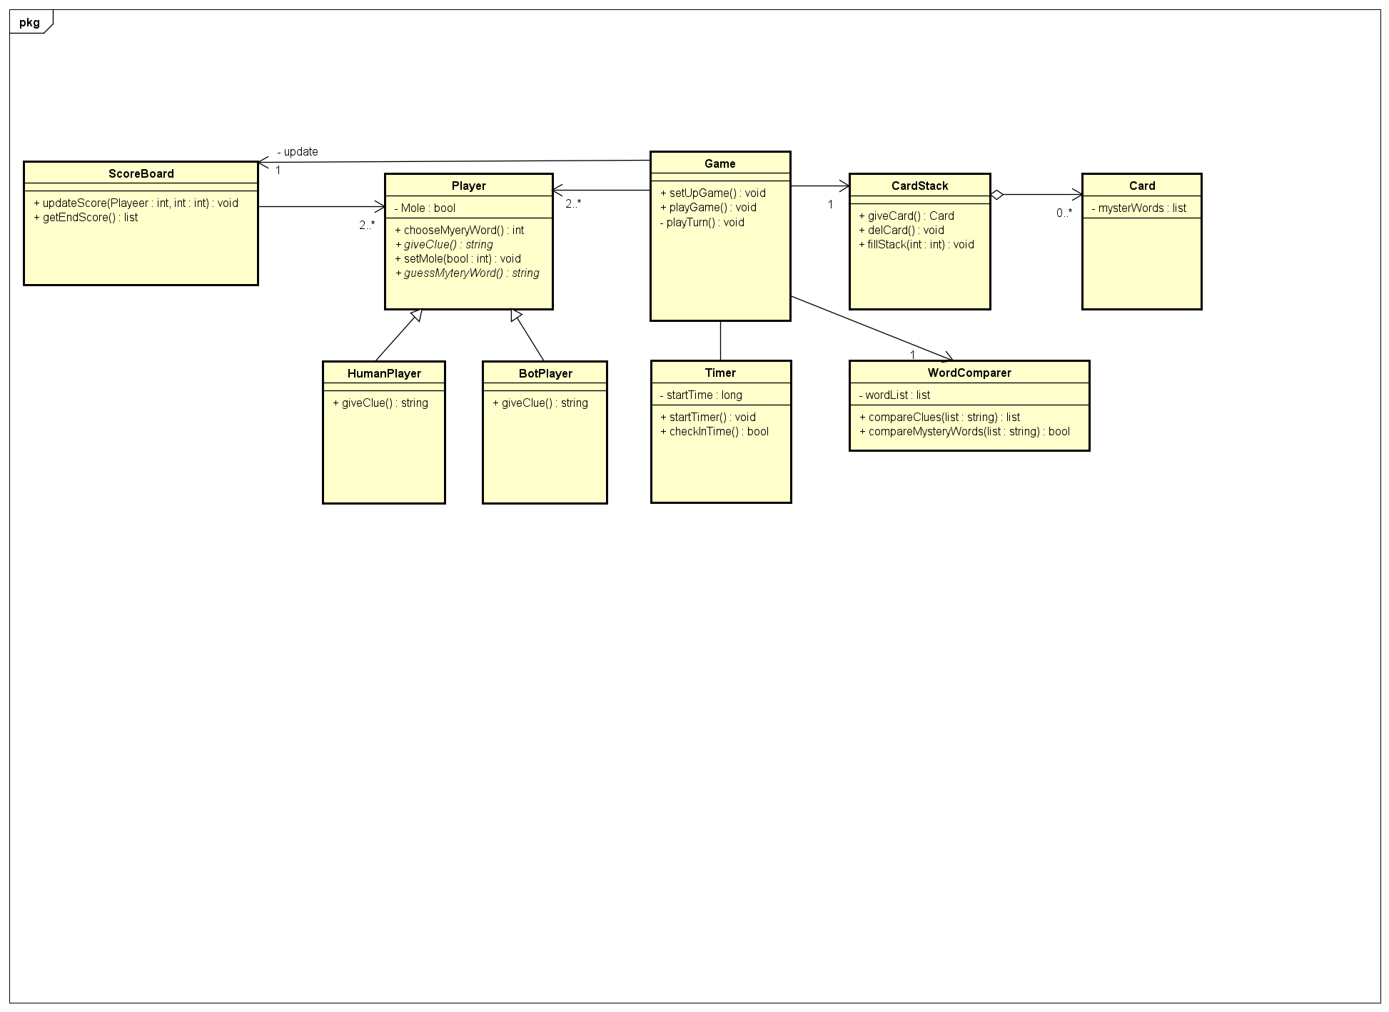
Diagrams
Class Diagram

Slide 15
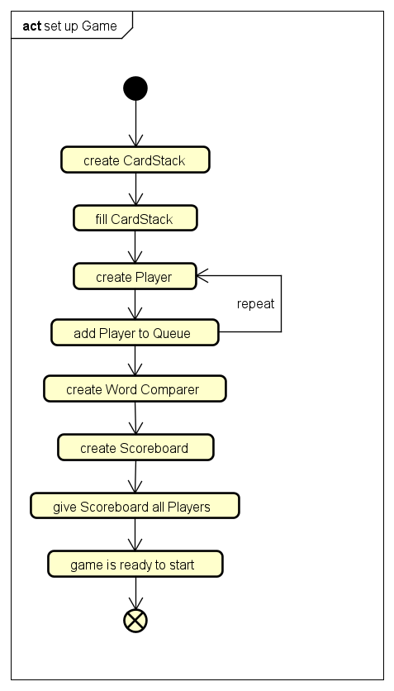
Diagrams
Activity Diagram (Create Game)

Slide 16
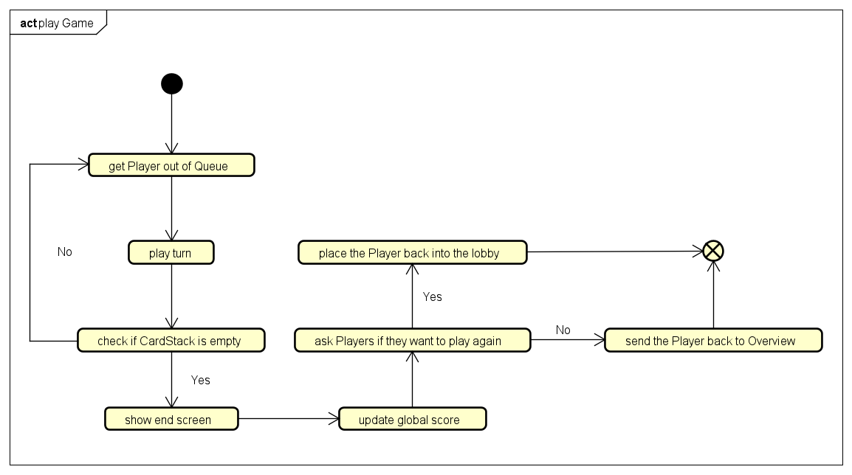
Diagrams
Activity Diagram (Game)

Slide 17
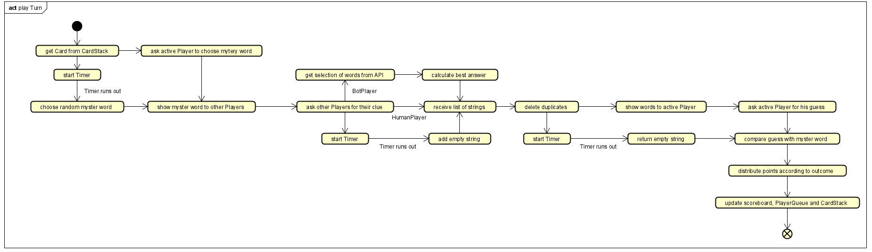
Diagrams
Activity Diagram (Turn)

Slide 18
User Stories and Sprints
User Stories can be grouped into six categories.
Game-Logic
Game-Control
Player-Control
Non-Human Players
Information
Further Ideas

Slide 19
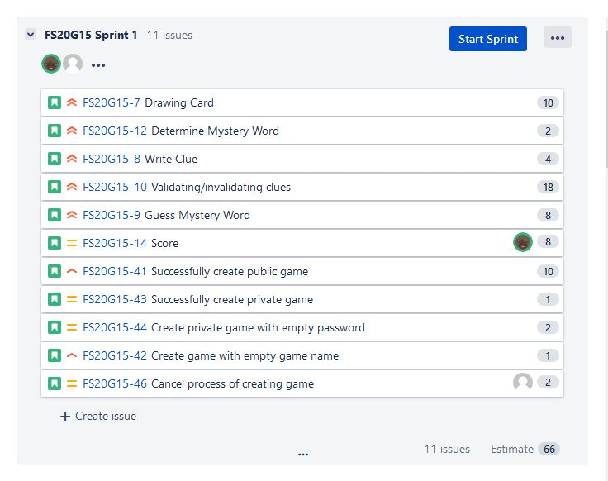
User Stories and Sprints
Five Sprints:
Game-Logic and Game-Control
Non-Human-Players and Game-Control
Game-Control and Player-Control
Information
Further Ideas
Frontend Team: Kai, Minh Phuong
Backend Team: Charlotte, Jordan, Raphael

Slide 20
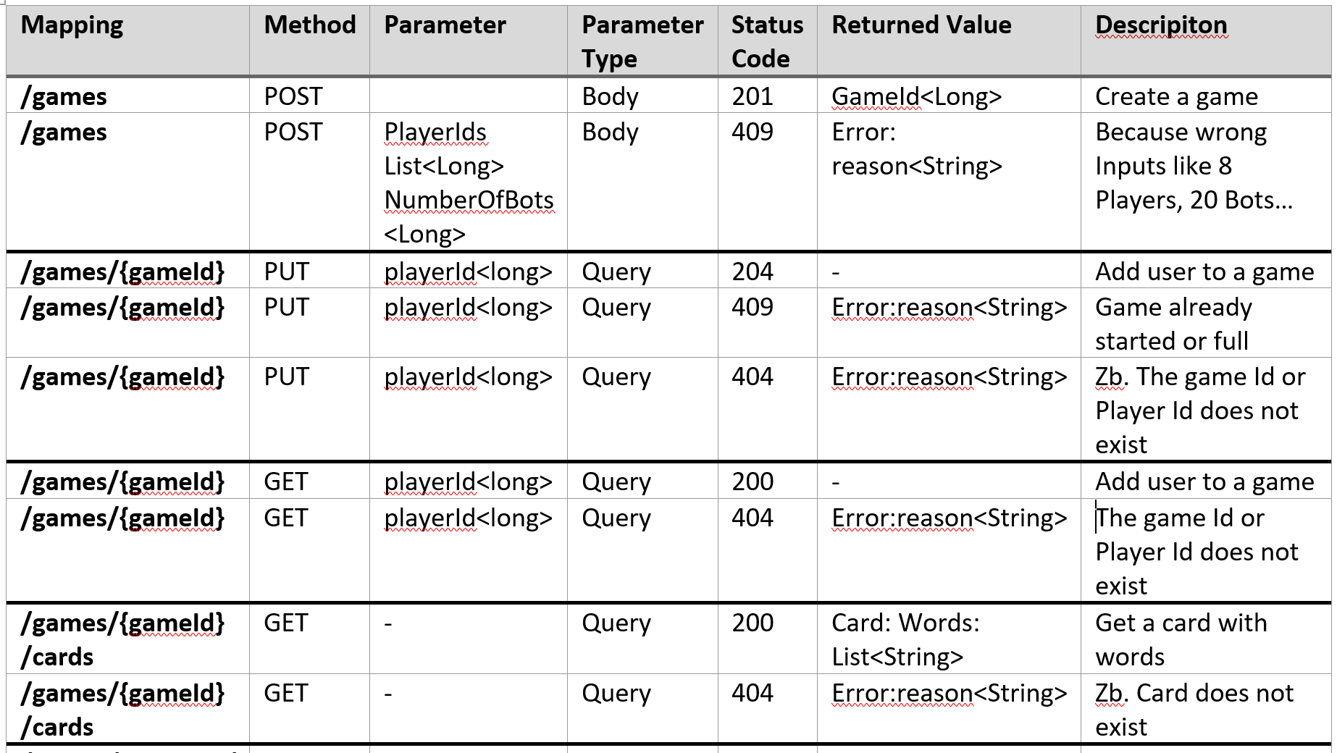
Rest Specifications

Slide 21
Test Cases
POST /games: Create a game
PUT /games/{gameId}: Put a player into a game-round
POST /games/{gameId}/clues: Give a clue
POST /games/{gameId}/guesses: Guess a mystery word
DELETE /games/{gameId}: Delete a game

